Slide 1
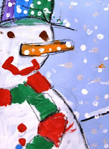
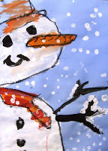
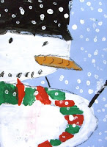
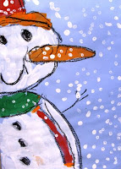
Up-Close Snowman
Project

Slide 2
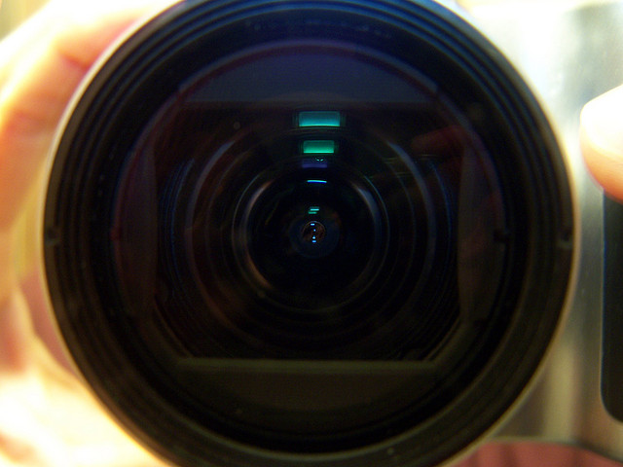
Zoom in on your subject

Slide 3
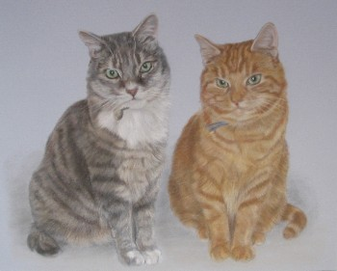
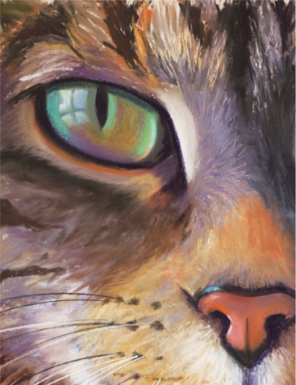

Slide 4
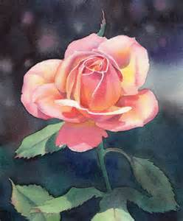
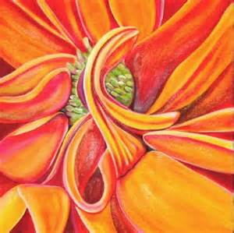

Slide 5
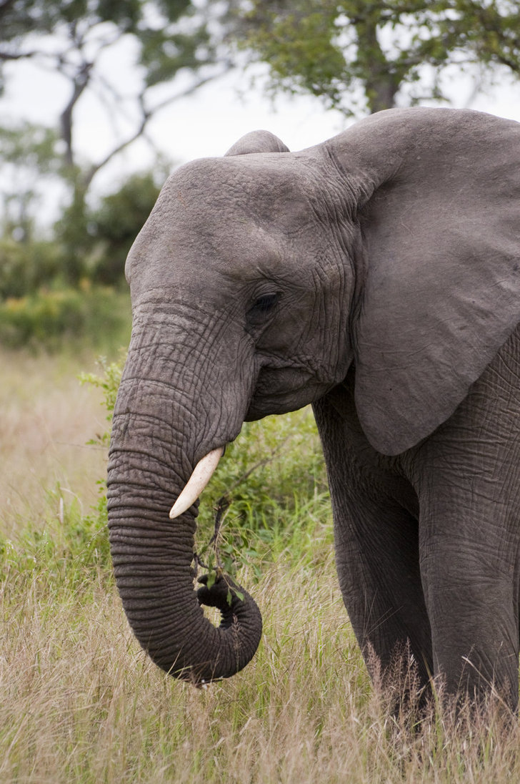
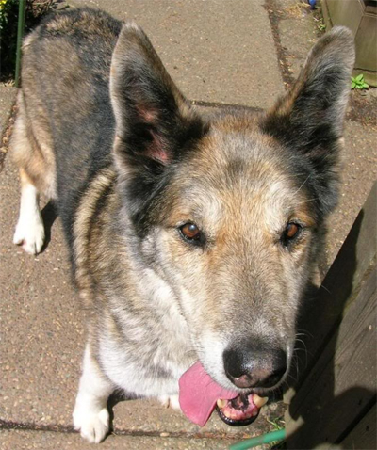
Look at your subject from a
different angle or perspective

Slide 6
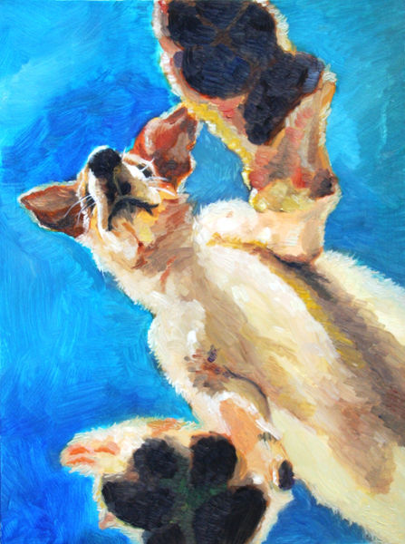
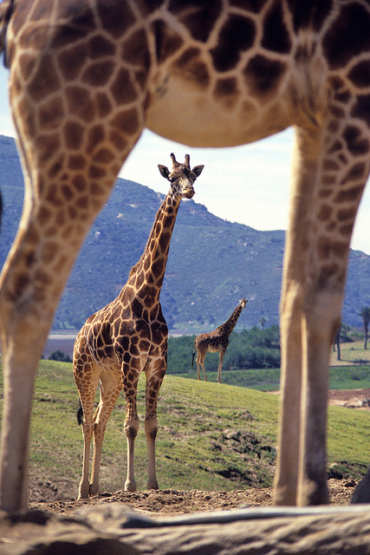

Slide 7

Snowman Portrait
When people draw snowmen they always draw them the same way… three circles stacked one on top of the other.
I challenge you to draw your snowman in a NEW way!
Let’s make some Snowmen
(or Snow-women) portraits!
Zoom way in!
Angle to the side

Slide 8
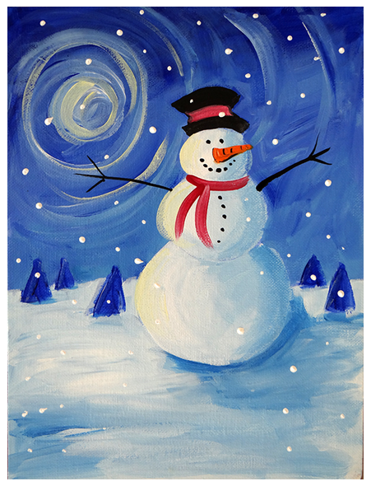
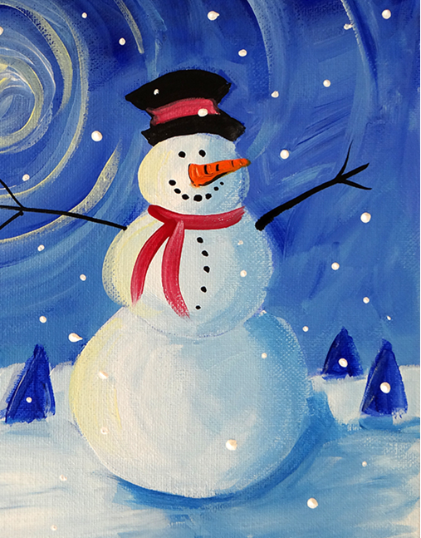
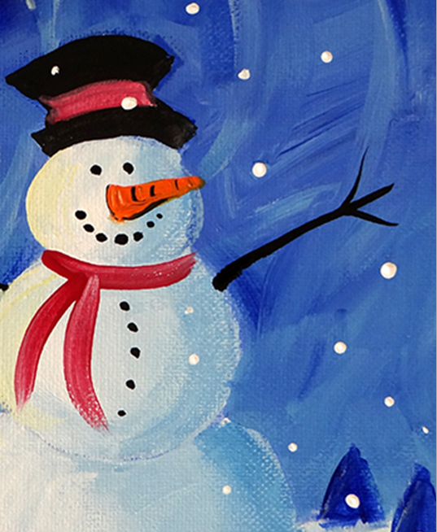
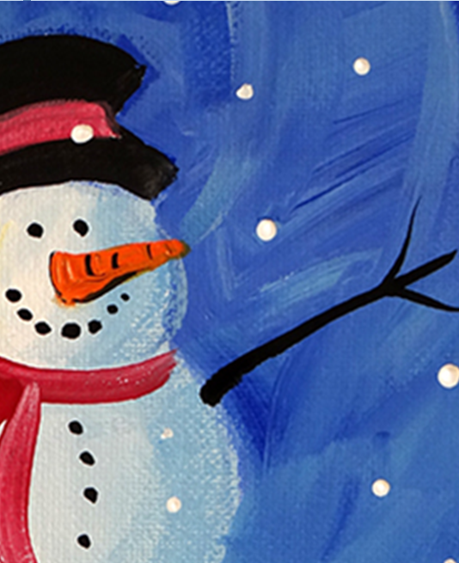
Snowman Close UP!

Slide 9
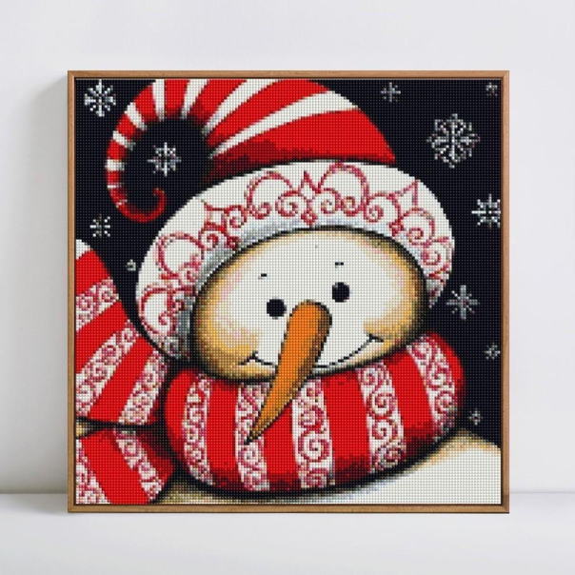
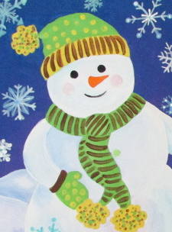
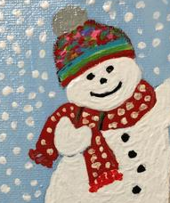
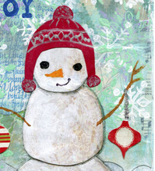
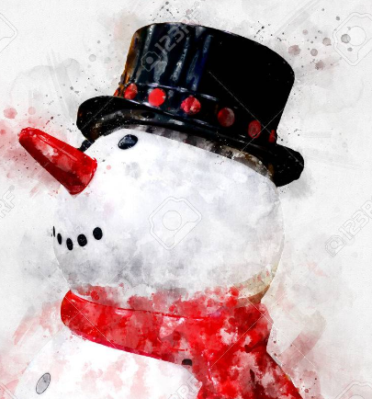
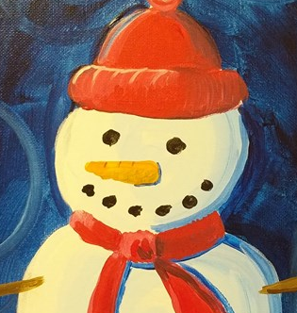
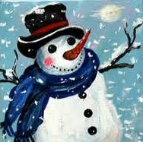
Snowman Hats and scarfs

Slide 10
Art Docent Prep:
Reserve end of hallway with your teacher (so acrylic paint doesn’t spill on the carpet)
Supplies Needed:
PowerPoint Presentation
Sample of Project on Canvas
Butcher paper on tables out in hallway
Sharpies for writing name on back of canvas frame
Canvases
Acrylic paint in containers (lg amounts of lt blue and white, small amounts of orange, black, red, green)
Water in cups for rinsing
Paintbrushes
Smocks (old shirts)
Q-tips
Black Oil Pastels
Drying rack

Slide 11
Drawing the snowman:
**Write your name on the back of the frame part of the canvas with a sharpie
With the canvas positioned tall rather than wide, use a pencil to draw a sideways letter “U” about a hands width down the left side on the canvas.
Draw a hat on top of this curved line (you will see that the first curved line is really the head) You can choose which type of hat you want (top hat, ski hat, etc.)
To make the body, position the pencil along the bottom part of the head and draw another curved line that reaches all the way down to the bottom of the canvas. Now we have a snowman and we didn’t draw one circle!
Add two dots for eyes, a big carrot nose that extends beyond the line for the face and a big smile.
To make the scarf, draw another curved line that matches the head shape. Add a scarf tail. Add buttons and one arm.
Trace all of your pencil lines with black oil pastel.
Painting the Snowman:
Use white acrylic paint to paint the snowman. While waiting for the white paint to dry, paint in the blue background. Next, use the other colored acrylic paints and paint the carrot nose, hat and scarf.
Snowflakes :
Use a Q-tip and dip it in white paint. Dot it all over the canvas (including the hat, scarf, etc.) to create snow falling.

